Slide 1

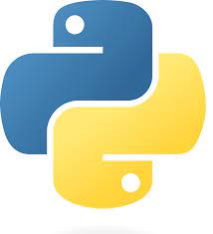
Python projects
Technical Training
21EG105D62- SMRUTI P
21EG105D32- AVISHKA L

Slide 2
PROJECTS
Machine Learning Project using sreamlit
The Classic Snake Game using tkinter
Romantic-Eli – an amazing virtual assistant for desktop

Slide 3
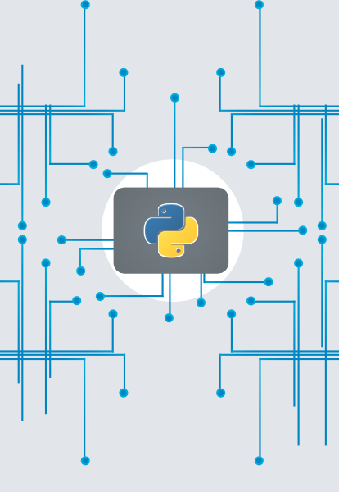
1. ML project using streamlit
This is an amaizing ML project. It’s basically a webpage which predicts the survival rate of a person. And we have developed this using streamlit and scikit.
All of us know about Titanic and people died in that accident. So in this project, we are going to make predictions whether anyone in a family survived in that accident or not based on the following input criteria:
Passenger ID
Passenger Name
Gender
Age
Siblings
Parents/Children
Ticket Number
Fare Amount
Cabin No
Embarkation point (In ship)

Slide 4
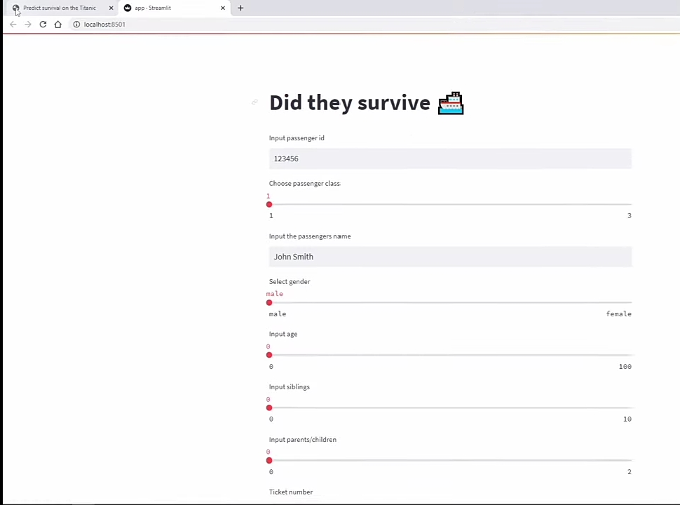
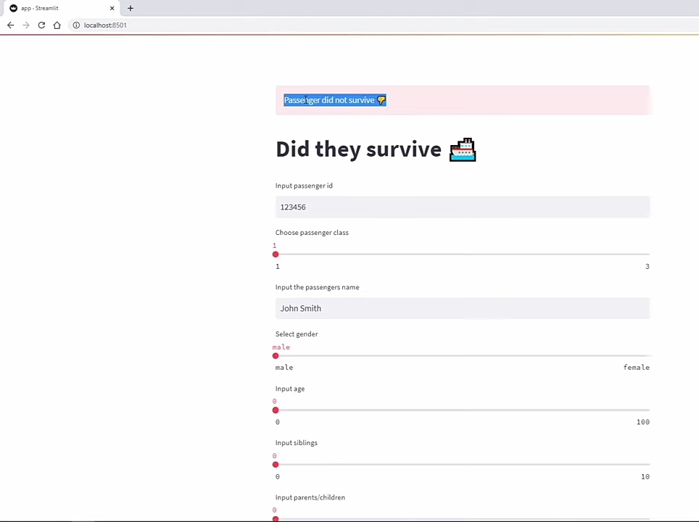
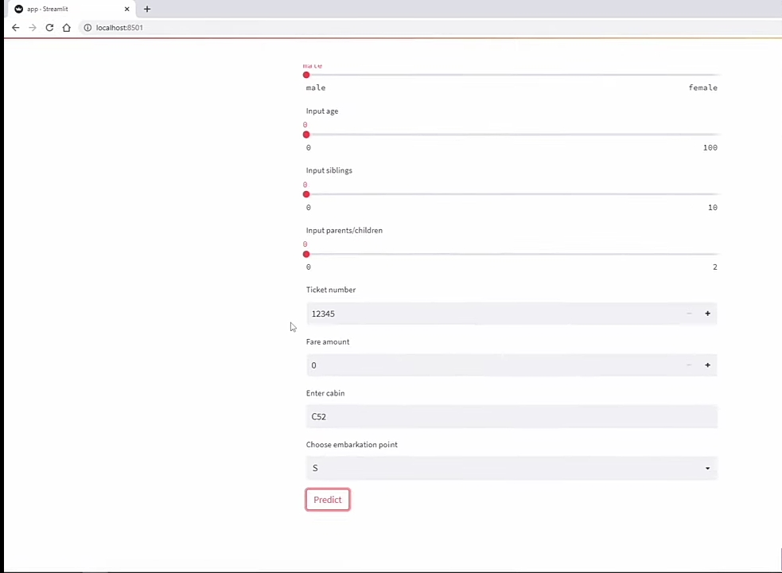
TEXT LAYOUT 02
This is the output we will get based on our input informations

Slide 5
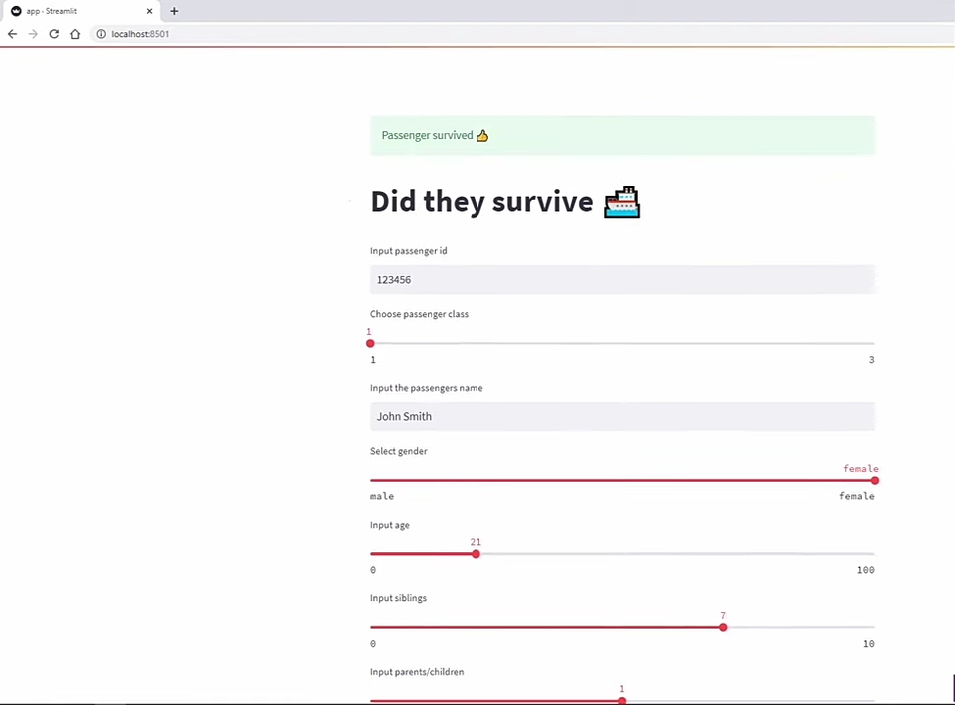
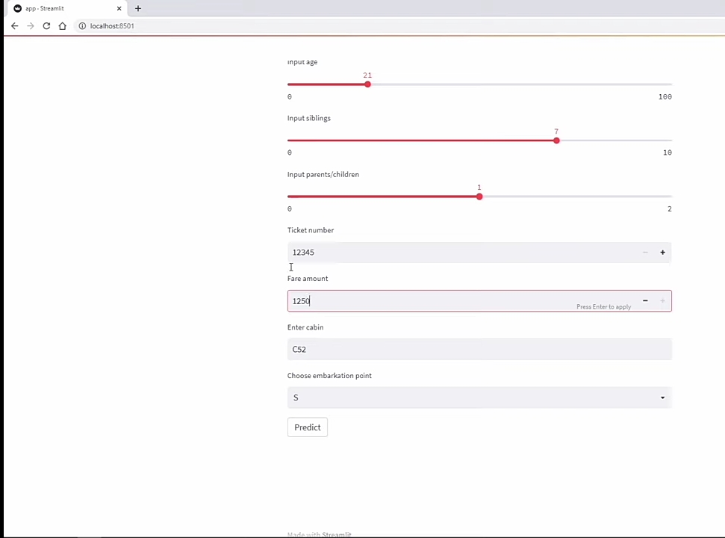
COMPARISON
SECTION 1 TITLE

Slide 6


Streamlit and scikit
Streamlit is an open-source Python library that allows you to quickly create interactive web applications for data science and machine learning projects. It simplifies the process of building and deploying web applications by providing an intuitive and declarative way to create user interfaces. With Streamlit, you can create interactive dashboards, data exploration tools, model demos, and more, directly from your Python scripts.
Scikit or Scikit-learn is a popular open-source machine learning library for Python. It provides a wide range of tools and algorithms for various machine learning tasks, including classification, regression, clustering, dimensionality reduction, and more. Scikit-learn is built on top of other scientific computing libraries in Python, such as NumPy, SciPy, and matplotlib, and integrates well with the broader Python ecosystem.
30%
25%
20%
Category Title
Category Title
10%
10%
5%
Category Title
Category Title

Slide 7
2. The Classic Snake Game
This is a simple GUI based project which we all used to play in our childhood and we have developed using python tkinter.
The classic Snake game is a popular and simple arcade game that originated in the late 1970s and gained significant popularity with the rise of mobile phones in the 1990s. The objective of the game is to control a snake on a rectangular grid, allowing it to eat food while avoiding collisions with walls and its own tail. As the snake eats the food, it grows longer, making the game progressively more challenging.
Phone:

Slide 8
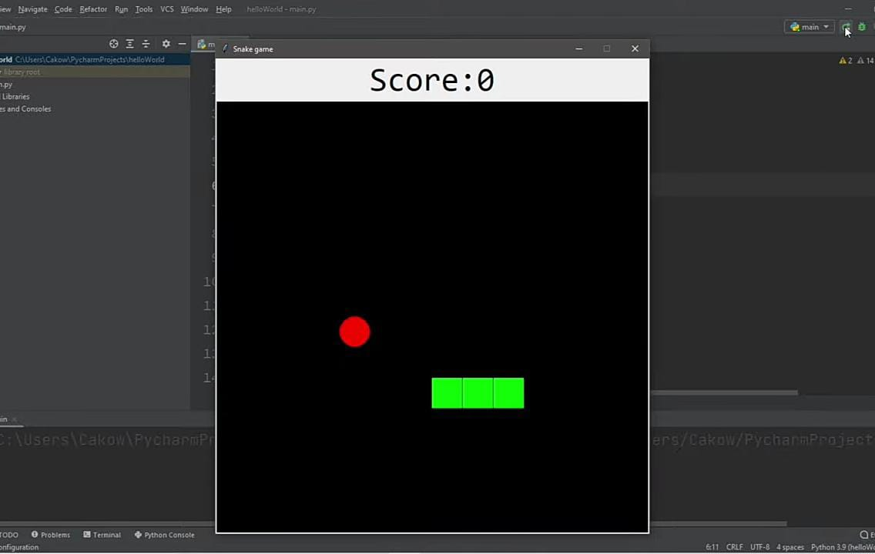
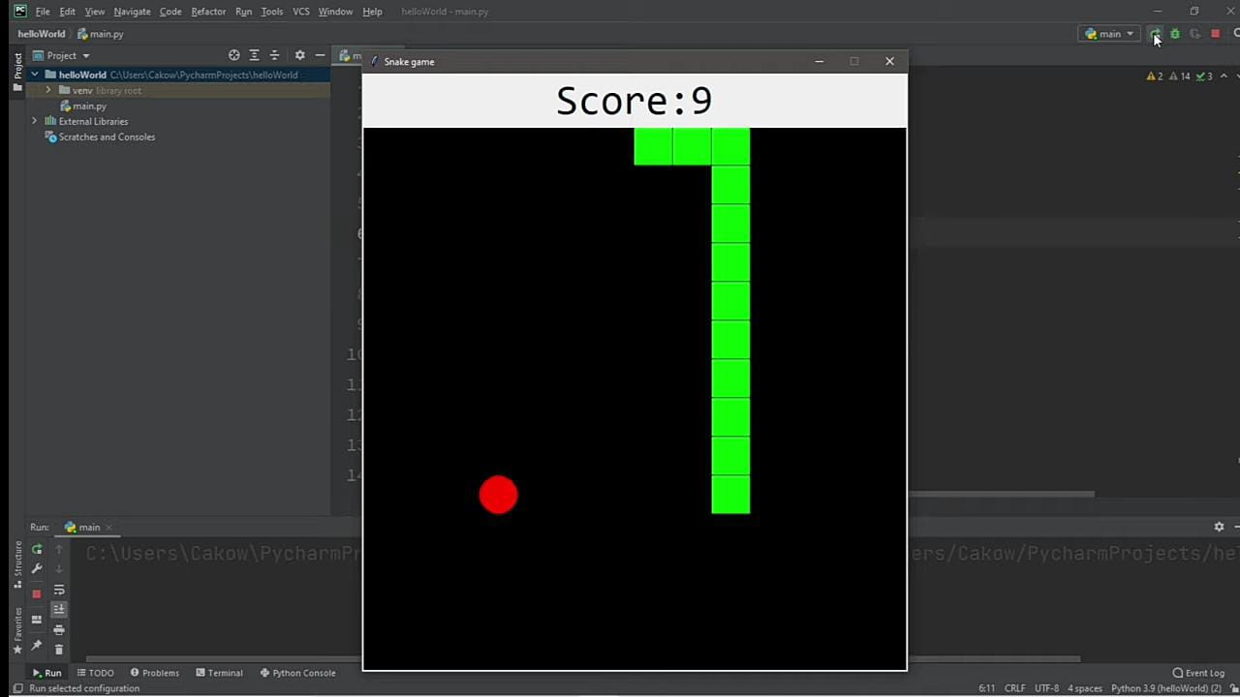
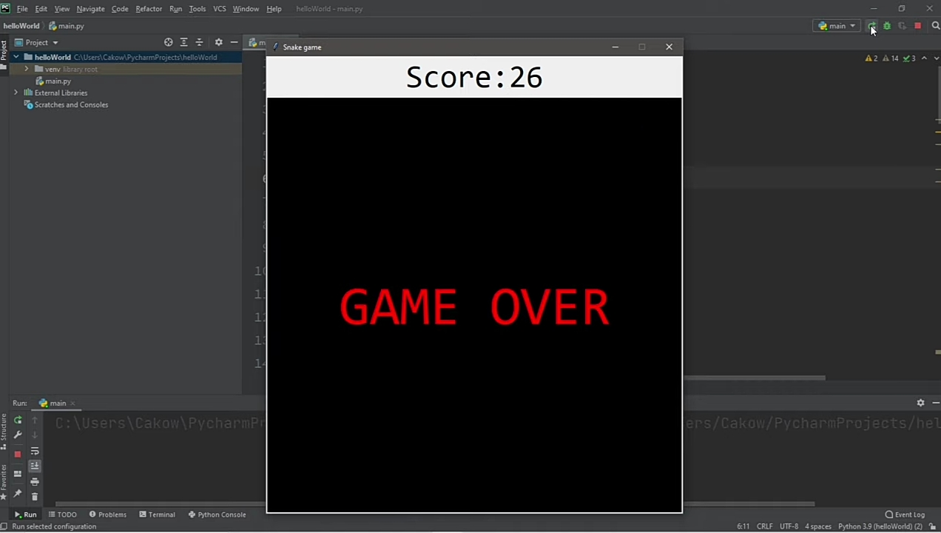
Here is the output

Slide 9
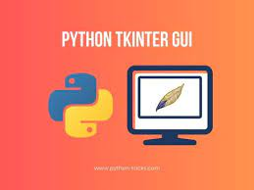
tkinter package in Python
Tkinter is a standard Python library for creating graphical user interfaces (GUIs). It provides a set of tools and widgets that allow you to build desktop applications with interactive windows, buttons, menus, input fields, and more. Tkinter is based on the Tk GUI toolkit, which originated in the Tcl programming language but has been widely adopted for Python development.

Slide 10
3. Romantic-Eli
Finally our 3rd project is an amazing desktop Virtual Assistant – Eli. Today’s technology is all about AI, ChatBots, Virtual assistants etc. So we have thought of making one. Because of python we could make it very easily.
Code Editor: Visual Studio Code
Python Packages(installed externally): Speech Recognition,pytts3(python text to speech version 3),pyAudio.
Now that’s it. This is the code. Run it, and Eli will be there to assist. We have to make sure that we address her – Eli, since in the code we have named our virtual assistant as Eli. Otherwise it won’t respond.

Slide 11
Speech Recognition
It is a Python library that provides an interface to various speech recognition engines, both online and offline. It allows you to convert spoken language into written text. The library supports multiple engines such as Google Speech Recognition, Sphinx, and Wit.ai, among others. With Speech Recognition, you can transcribe audio from various sources, including microphone input and audio files.
pytts3(python text to speech version 3)
It is a Python library for text-to-speech conversion. It enables you to convert written text into spoken words. pyttsx3 is a cross-platform library that supports multiple TTS (Text-to-Speech) engines, including Windows SAPI5, macOS NSSpeechSynthesizer, and Linux eSpeak. It allows you to control speech properties like voice, speed, volume, and more.
pyAudio.
It is a Python library that provides bindings for the PortAudio library, allowing you to easily work with audio input and output devices. PyAudio provides functions and classes to interact with microphones and speakers, making it useful for tasks like audio recording, audio playback, and audio streaming. It is often used in conjunction with other libraries, such as Speech Recognition, for building voice-based applications.
.

Slide 12

It was really cool and fascinating doing such amazing projects. Python made it awesome and more fun. As you can see, the lines of code are shorter and simpler. It is all about extensive python libraries. It is a vast pool. The more we understand and learn about these libraries the more we will be able to do such amazing projects in no time.

